Slide 1

Lesson: 1.04 Variable Input
Microsoft Philanthropies TEALS Program
Introduction to Computer Science
Semester 2

Slide 2
Variable Input
After this lesson, you will be able to...
Define and identify comments, storing, mutability, variable assignment, input
Assign and swap variables
Store user input into a variable

Slide 3
Plan
Do Now
Continue Do Now & Discussion
Magic Genie Lab
Debrief/Quiz Prep
Notes:
5 Minutes - Do Now
20 Minutes - Continue Do Now & Discussion
20 Minutes - Magic Genie Lab
10 Minutes - Debrief/Quiz Prep

Slide 4
Do Now
Type the following in your Console
a = input("What is your name? ")
# a = "cats and dogs“
# meow
print("Hello there, " + a)
In Your Notebook, respond to the following
Read through the code and write down what you expect the printed results to be?
Run the code and write down the actual printed result?
Briefly describe what the # does?
Briefly describe what input does?

Slide 5
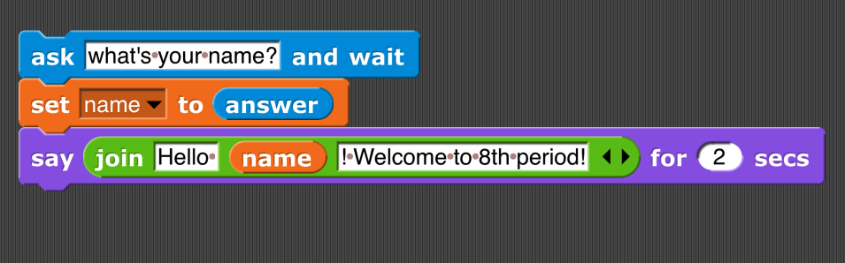
Discussion - What does the code do?

Slide 6
Code Comment
What happens when I run the statement above?
A: Absolutely nothing!
Why?
A: Because “#” makes it a comment

Slide 7
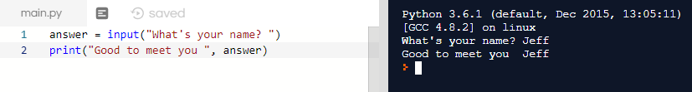
Input Statement
What’s the input statement for?
A: Lets you input data and save it to a variable

Slide 8
Input Statement - String
BTW, what’s the data type of value saved to answer?
A: It’s a string. The input statement always returns a string.

Slide 9

Input Statement - Error
What will happen when I run this code?
A: It will give me an error!

Slide 10

Input Statement – int()
So you have to do something called “casting”.
You cast a value to an integer with the int() function.

Slide 11
Casting
Converting between data types
input() always gives us a string, sometimes we want an integer, a float, or a bool
We can use a casting function to convert between the different types:
When concatenating or adding (both with “+”) —> Types have to match up
73 + 73 = -
“73” + “73” = ‘7373’
“73” + 73 = TypeError
Desired Type | Casting Function | Example
Integer | int() | int(“73”)->73
String | str() | str(73)->’73’
Float | float() | float(73)->73.0
Bool | bool() | bool(73)->True

Slide 12
Swapping Variables
a = "this sentence should go second"
b = "this sentence should go first."
# your code starts here
# your code ends here
print(a)
print(b)

Slide 13
Swapping Variables – From The Do Now
a = "this sentence should go second"
b = "this sentence should go first."
# your code starts here
c = a
a = b
b = c
# your code ends here
print(a)
print(b)
How would you swap a and b?

Slide 14
Lab – Magic Genie
Project Objective
Use Python to interact with variables and user input
Create a genie program. Save the file as magic_genie.py.

Slide 15
Project Specifications
Have the program introduce itself
Have the program ask for three separate wishes
Print all the wishes together
There are some repeated strings in this genie program.
Move those into variables
Image of Output. Here is the test
I am a genie. You have three wishes
What would you like to wish for? cats
What would you like to wish for? kittens
What would you like to wish for? more cats
Your wishes are cats, kittens and more cats

Slide 16
Genie Confusion
Now it’s time to make your genie confused.
Edit your code to have him
Print your first wish as your last wish
Your second wish as your first wish
Your third wish as your second wish.
I am a genie. You have three wishes
What would you like to wish for? cats
What would you like to wish for? kittens
What would you like to wish for? More cats
Your wishes are kittens, more cats and cats

Slide 17
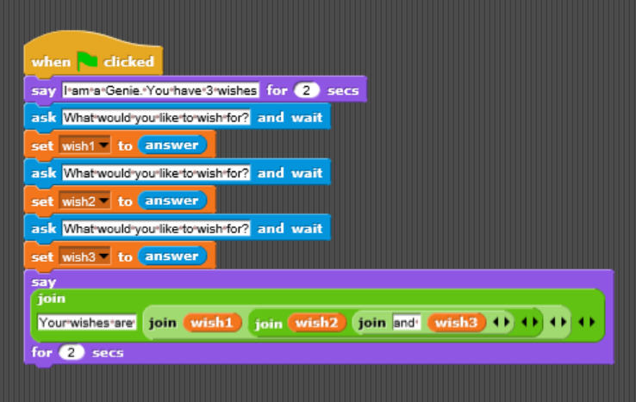
Snap! Flashback
Look at how you would write this code in Snap!

Slide 18
Hint
Remember to add spaces you can combine " " to the end of your string using the + operator.
So print("hello" + " " + "student") would print hello student

Slide 19
Exit Ticket/Debrief
In your Notebook, Write down one thing you learned today.

